Slide 1
Siti Nurafifah alice yap
Maisqual Projects/Ant Analysis

Slide 2
Agenda
Background information of Maisqual Projects/Ant Dataset
Alice’s analysis
Siti’s analysis

Slide 3
Background information of Maisqual Projects/Ant Dataset
research project intends to fill the gap between both fields by proposing a controlled and peer-reviewed data set series ready to use and study.

Slide 4
Alice’s analysis
1) Does more source lines means there is more effective lines?

Slide 5
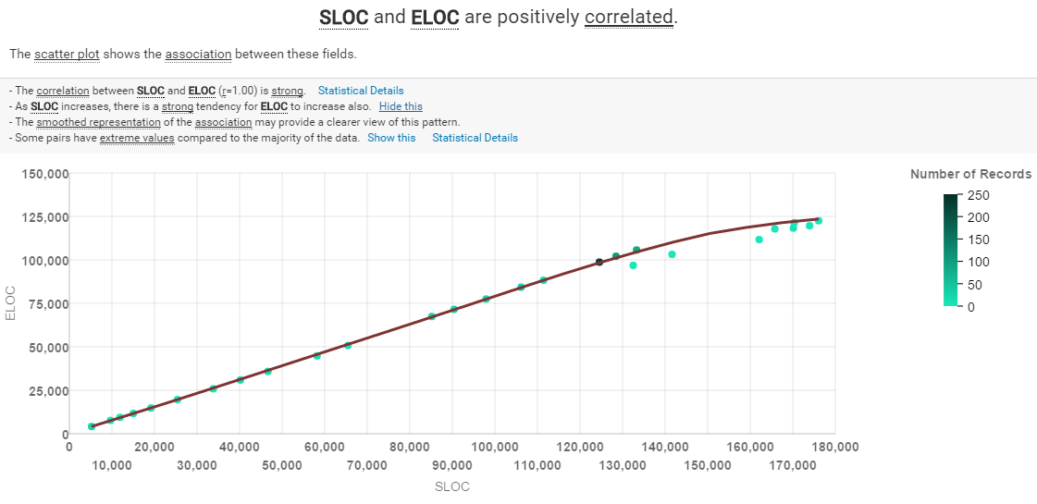
SLOC----source lines of code
ELOC----effective lines of code
From the regression graph we can see that source lines of code and effective lines of code is positively correlated

Slide 6
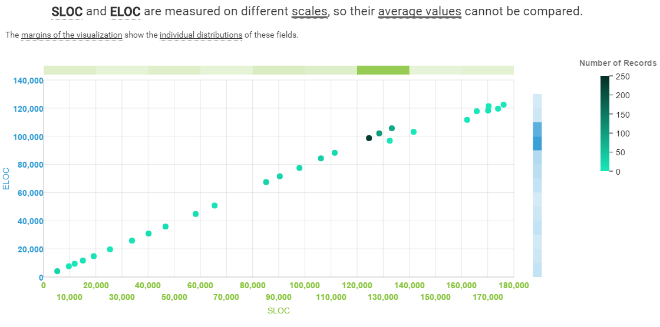
SLOC----source lines of code
ELOC----effective lines of code

Slide 7
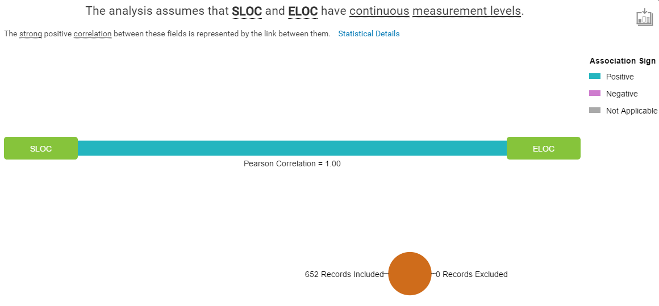
SLOC----source lines of code
ELOC----effective lines of code
Looking at the Pearson Correlation which is 1, it indicate that there is a strong positive correlation between them. We can conclude that when there is more source lines of code, there is more effective lines of code.

Slide 8
Alice’s analysis
2) How effective is the communication between users and developers?

Slide 9
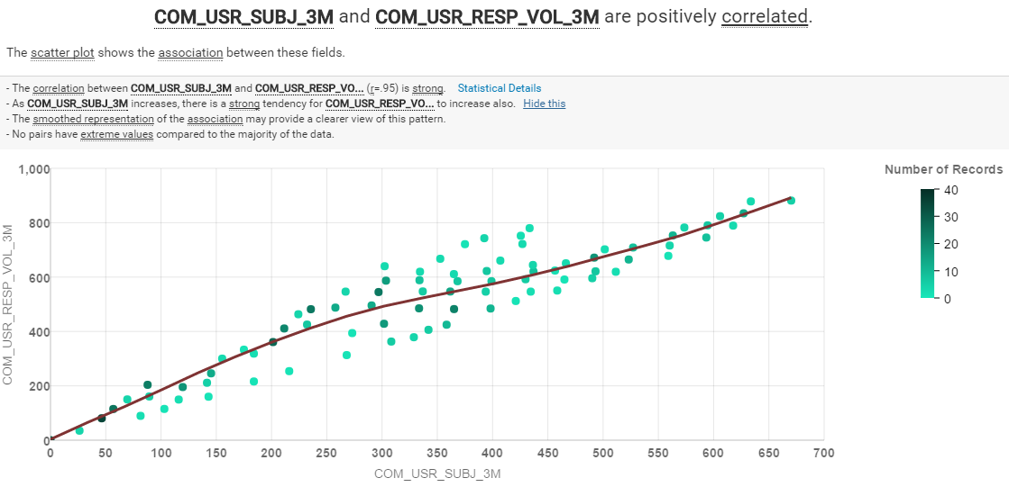
COM_USR_SUBJ_3M----the number of different subjects (eg. A question and its response) that have been posted on the mailing list in the last 3 months
COM_USR_RESP_VOL_3M ----the total number of replies to requests on the user mailing list in the last 3 months

Slide 10
From the regression graph we can see that the number of different subjects that have been posted on the mailing list in the last 3 months and the total number of replies to requests on the user mailing list in the last 3 months is positively correlated.

Slide 11
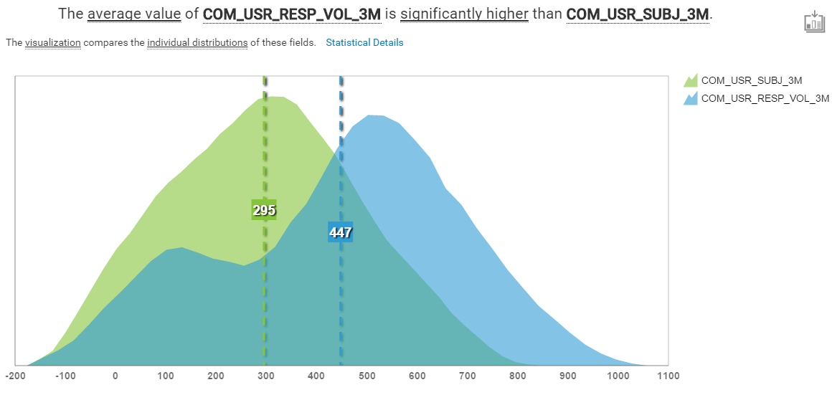
COM_USR_SUBJ_3M----the number of different subjects (eg. A question and its response) that have been posted on the mailing list in the last 3 months
COM_USR_RESP_VOL_3M ----the total number of replies to requests on the user mailing list in the last 3 months

Slide 12
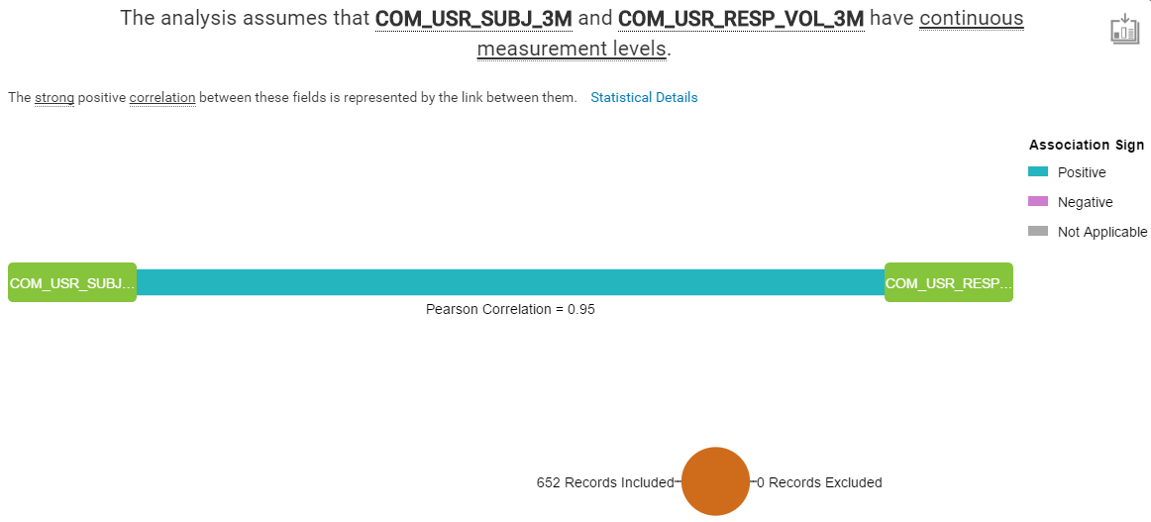
COM_USR_SUBJ_3M----the number of different subjects (eg. A question and its response) that have been posted on the mailing list in the last 3 months
COM_USR_RESP_VOL_3M ----the total number of replies to requests on the user mailing list in the last 3 months

Slide 13
Looking at the Pearson Correlation which is 0.95, it indicate that there is a strong positive correlation between them. We can conclude that when there is more number of different subjects that have been posted on the mailing list, there is more total number of replies to requests on the user mailing list. Which suggest that there is an effective communication between users and developers.

Slide 14
Siti’s Analysis
The more the number of developers involved, the more bugs fixed and increase of number of commits.

Slide 15
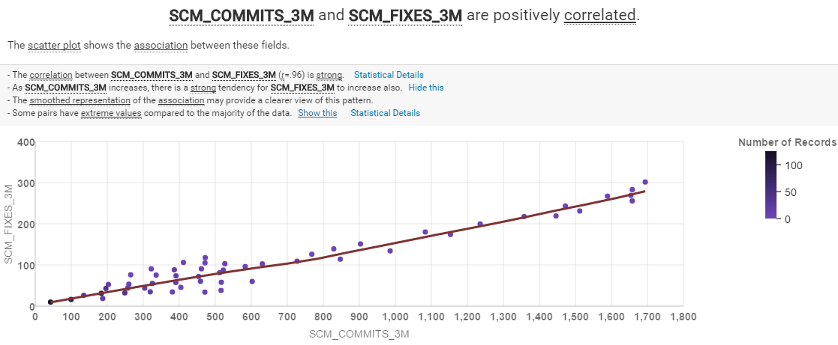
SCM_COMMITS_3M: Number of commits during the last 3 months(count the commits registered by the software
Configuration management tool for the artefact on the repository)
SCM_FIXES_3M: Number of fixes during the last 3 months(counts the number of fix-related commits)
From the scatterplot, we can see that both inputs are positively correlated as the regression line is flat.

Slide 16
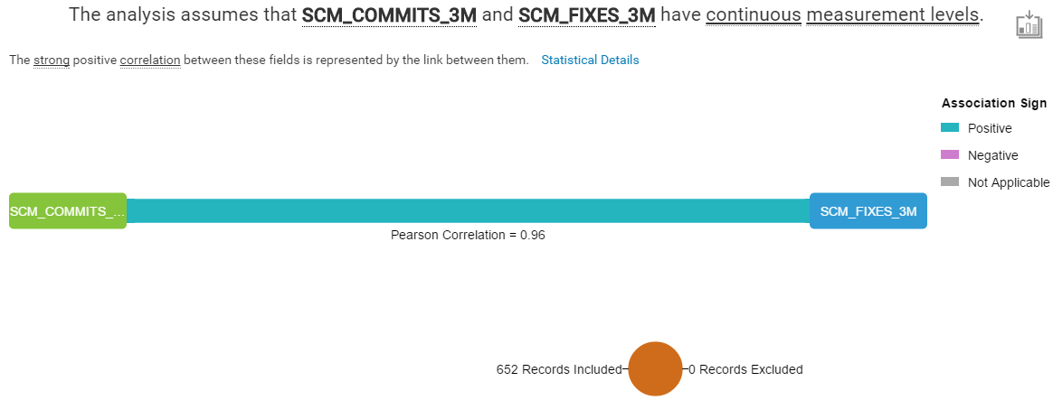
The strong positive correlation between these fields is represented by the link between them.
The correlation between SCM_COMMITS_3M and SCM_FIXES_3M (r=0.96) is strong.
As SCM_COMMITS_3M increases, there is a strong tendency for SCM_FIXES_3M to increase also.

Slide 17
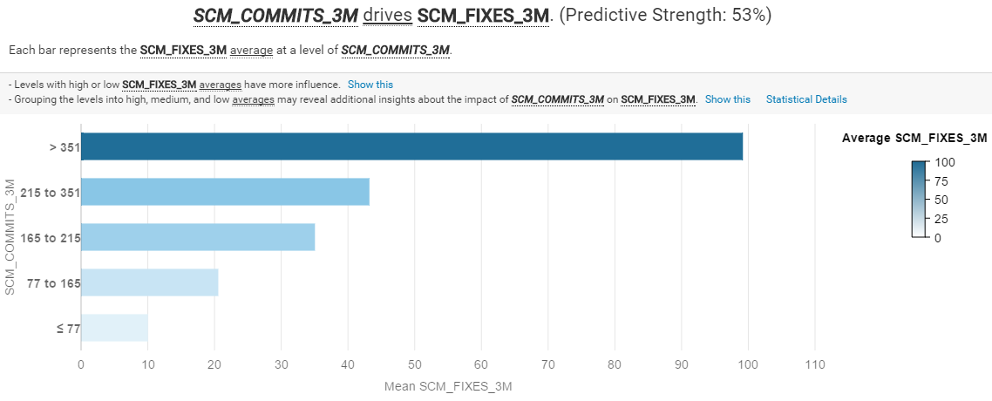
Seeing this bar chart, it shows that the higher the average value of fixes,
the more commits happened.

Slide 18
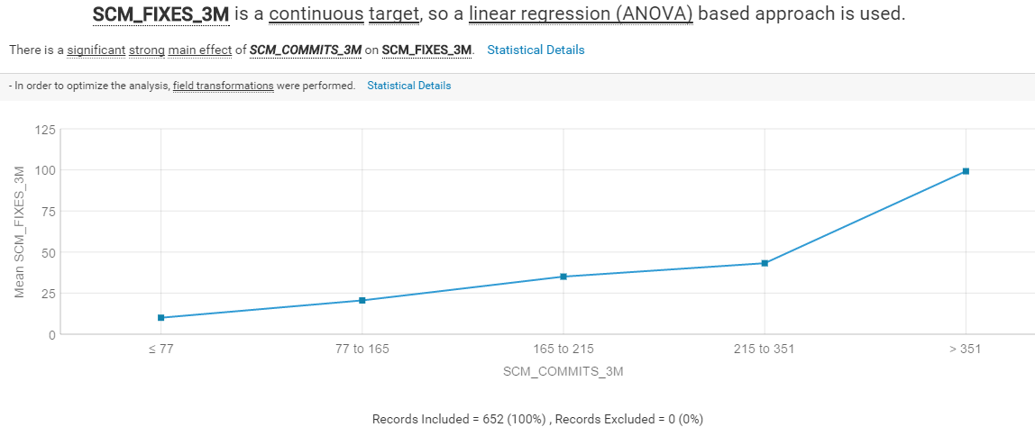

Slide 19
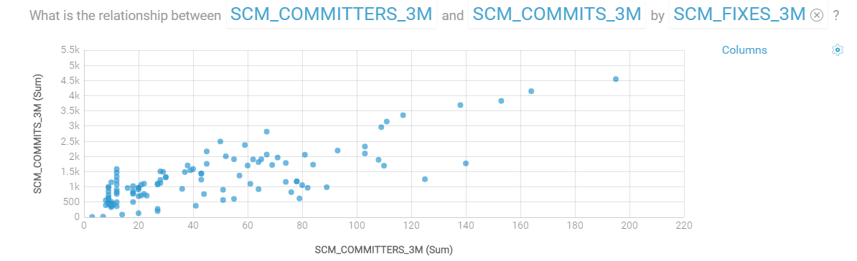
SCM_COMMITTERS_3M: Number of distinct committers
This scatterplot shows that the relationship between committers and commits is rather
linear proving that with more contributions from committers, more commits are happening.

Slide 20
Conclusion
Looking at the scatterplots and relationship graphs between SCM_COMMITS_3M, SCM_COMMITTERS_3M & SCM_FIXES_3M shows that they are related to one another. This high correlation between them also suggests that these effects are somewhat bounded together.
Proves that the statement is right.

Slide 21
Thank you

Slide 22
References
http://maisqual.squoring.com/wiki/index.php/Maisqual_Metrics
http://maisqual.squoring.com/wiki/index.php/Maisqual_Projects/Ant

